Slide 1
Protein Changes in the Aging Heart
Daniel Alfonsetti
JAX Summer Student Program 2018
Notes:
Hi friends, my name is Daniel. I’ve been working in the Churchill lab this summer studying how proteins change in the heart as you age.

Slide 2
Background
Cardiovascular disease is the leading cause of death in the US and the world.
A strong predictor of CV health is having healthy parents.
Evidence for genetic component
Perls T, Terry D. Understanding the determinants of exceptional longevity. Ann Intern Med. 2003 Sep 2;139(5 Pt 2):445-9. Review. PubMed PMID: 12965974.
Notes:
So why is this research important? Well, its because cardiovascular disease is the leading cause of death in the world.

Slide 3
The Data
189 genetically diverse mice
6, 12, 18 months; both sexes
Measured abundance of 4193 heart proteins
Notes:
The data that I used came from a cross-sectional study with 189 diversity outbreed mice grouped by age. For each mouse, the expression levels of 4193 proteins and 21169 transcripts in the heart were measured. I’d just like to emphasize the terminology by saying that this is not a longitudinal study since we are not measuring the same mouse at different ages.

Slide 4
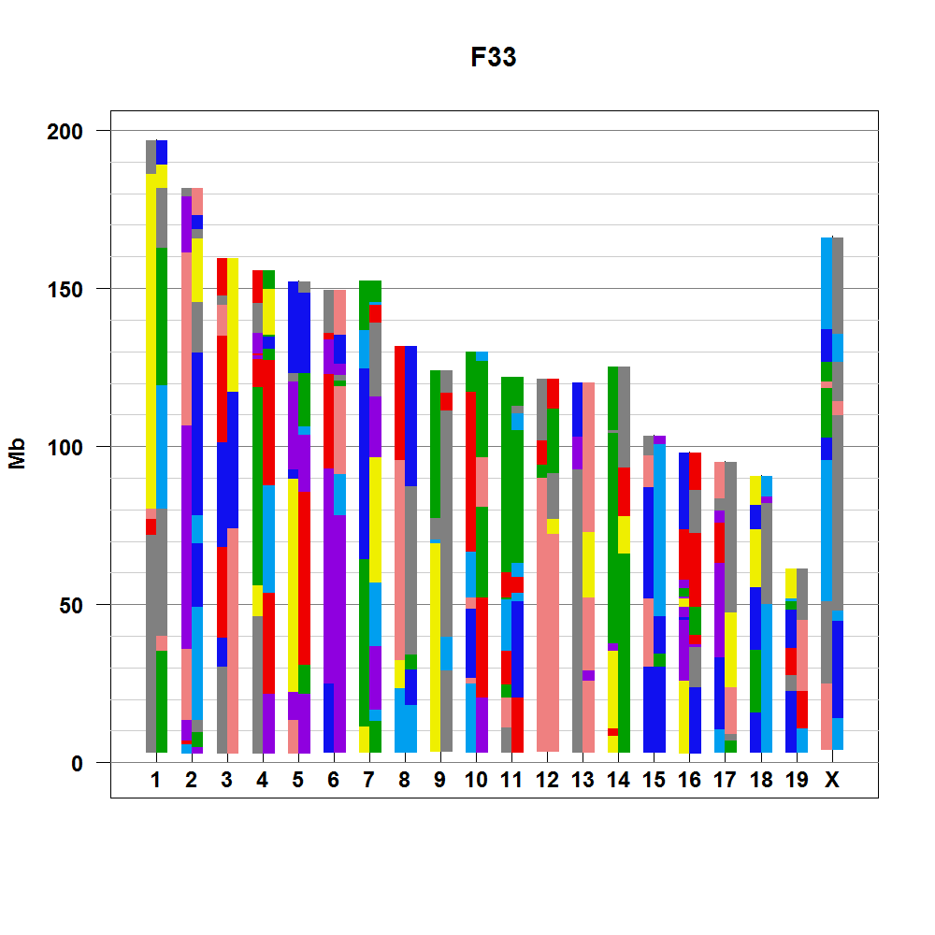
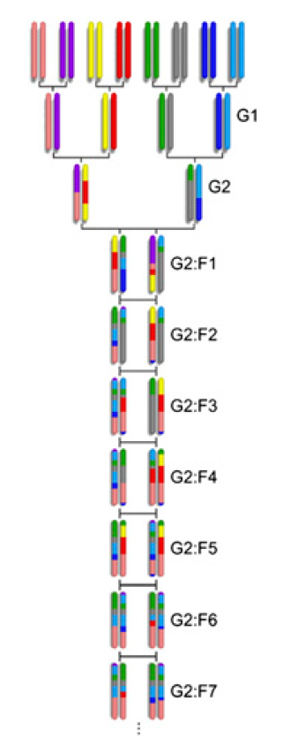
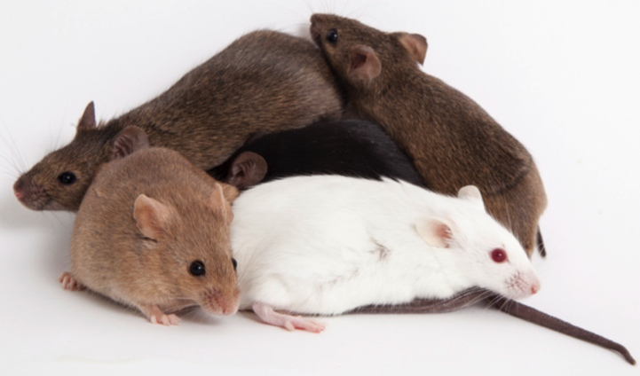
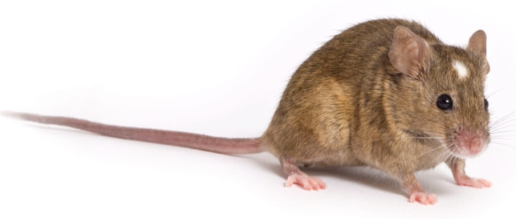
Diversity Outbred
Collaborative Cross
Founder
Strains
Multiparental
Population
(DO)
Partially Inbred
Progenitors
Inbred
Strain
(CC)
Randomized Breeding
Notes:
So like I said, my mice were diversity oubred, or “DO” mice. So I’ll give you a quick history of them. First there were the 8 founder strains, 5 of which were laboratory mice that have been in labs for awhile, since like the early to mid 1900s, and the other three are ‘wild-type’ strains. These wild type strains have more genetic diversity than the inbred strains. Nonetheless, every strain is inbred and thus homozygous at every genetic location, meaning they are clones.
More genetic diversity, recombination distances are smaller.
CCs were created with 3 generations of funnel breeding between the 8 founders and then 20 generations of inbreeding.
DO were created by continuously outbreeding different lines of CCs.
Since each DO mouse is genetically unique (they are not clones), each one must be sequenced separately. They are genotyped with the Mouse Universal Genotyping Array (MUGA).

Slide 5
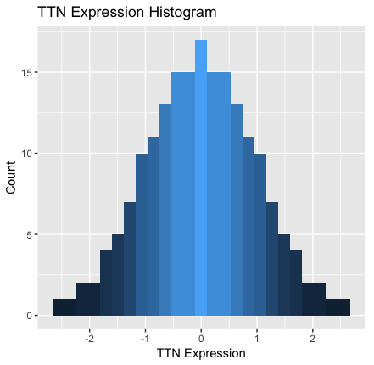
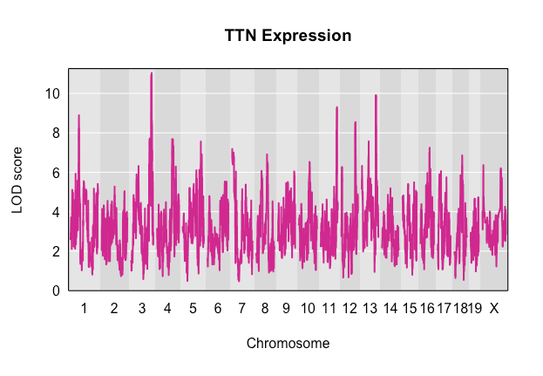
Quantitative Trait Locus (QTL) Mapping
Method of associating genome location to quantitative trait
Regress phenotype on genotype at every SNP
TTN Expression
LOD
Chromosome
Notes:
Okay, so that’s all well and good, but we want to find what parts of the genome are actually driving these correlations.
Place in the genome that influences a trait

Slide 6
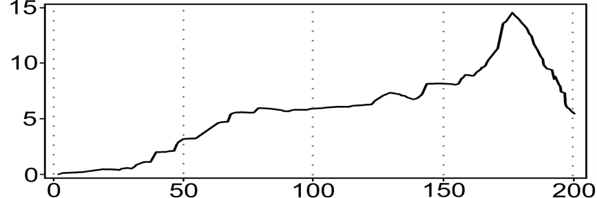
Cholesterol
AA
AB
BB
AA
AB
BB
AA
AB
BB
LOD
Chr Location
Credit: Dan Gatti
Notes:
So on the bottom is a picture of what a QTL looks like.
Go across the genome and look to see how well the genotype predict the phenotype.
“Predict”

Slide 7
Genotype effect on expression varies with age
6 Months
12 Months
18 Months
Protein Expression
AA
AB
BB
AA
AB
BB
AA
AB
BB
LOD
Chr Location
Notes:
So in this example, you older mice tend to have more cholesterol regardless of genotype. However, depending on your genotype, you may have more cholesterol at any given age than you would if you had another genotype.
Each genotype has about the same distribution of cholesterol
“The

Slide 8
Gene position
Count
QTL Position
Notes:
One interesting thing about pQTL is that we don’t see as many having cis regulation as we do in eQTL maps. Anyways

Slide 9
Notes:
Sliding window of size with increments of

Slide 10

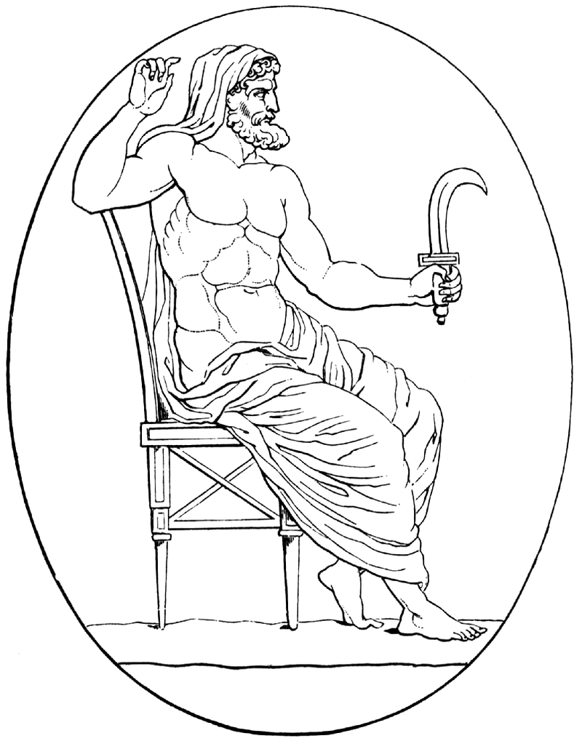
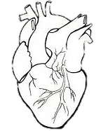


The Genes
Ttn – Titin. Largest protein. provides structure, flexibility, and stability to sarcomeres.
Myh6 – Myosin heavy chain 6. Structural component of sarcomeres; helps generate mechanical force needed for contraction.
Mybpc3 – cardiac myosin binding protein C, keeps thick filaments in cardiac sarcomeres from breaking down.
Actg2 - gamma (γ)-2 actin. Forms filaments useful in muscle contraction.
Enriched Categories
Cardiac muscle tissue morphogenesis
Regulation of heart rate
Cardiac muscle contraction
Hypertrophic Cardiomyopathy
Notes:
Ttn – Largest protein in the human body. It’s even larger in the mouse. 3,816,188.13 g/mol in the human, 3,906,487.6 g/mol in the mouse. https://en.wikipedia.org/wiki/Titin
Myh6 - https://ghr.nlm.nih.gov/gene/MYH6
Mybpc3 – Also regulates speed of contraction. https://ghr.nlm.nih.gov/gene/MYBPC3
Actg2 –
Ank2 – Expressed everywhere, but particularly in the heart.
“Alterations in ankyrin-B expression levels are observed in human heart failure.” -https://en.wikipedia.org/wiki/ANK2
https://ghr.nlm.nih.gov/gene/ANK2
Dsp – Desmoplakin, desmosome structural component, keeps adjacent cells together
Desmosomes are structures that keep two adjacent cells together. They are particularly important in tissues that experience mechanical stress, such as heart tissue. https://www.ncbi.nlm.nih.gov/pmc/articles/PMC2742091/

Slide 11
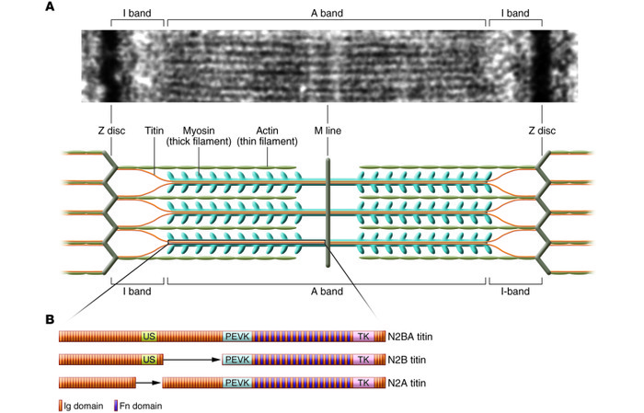
Notes:
So there are long muscle fibers in the heart that are called myocytes, and they contain these long strains that run the length of the cell called myofibrils. And in each myofibril are a series of things called sarcomeres. The sarcomeres are the fundamental unit of muscle contraction. They have thick and think filaments that slide past each other.

Slide 12
TTN (ENSMUSP00000011934) pQTL with Age:QTL interaction
LOD Score
Chr 3 Position

Slide 13
SNP Association
LOD score
Chr3 Position
Notes:
TTN (ENSMUSP00000011934) expression SNP association mapping plot. Interactive covariate = Age.
Underneath SNP with maximum LOD score are linkRNAs.

Slide 14
lincRNA Gene Expression Regulation Example
Baldassarre, Antonella & Masotti, Andrea. (2012). Long Non-Coding RNAs and p53 Regulation. International journal of molecular sciences. 13. 16708-16717. 10.3390/ijms131216708.
Notes:
There has been a lot of

Slide 15
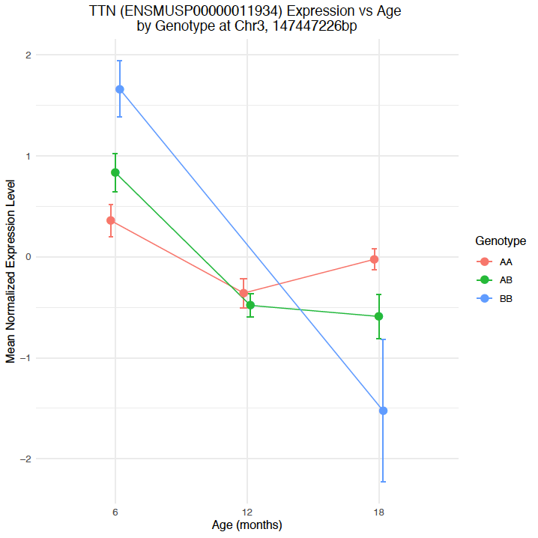
Notes:
Here we are assuming that all markers are bi-allelic, so all of the minor alleles get coded the same as “B”

Slide 17
Summary
Expression of structural heart proteins decreases with age
Rate of decline depends on genotype
Rate driven by locus at Chr3, ~148 Mbp
Regulated by lincRNA?

Slide 18
Next Steps
Wet lab work. Knockout lincRNA in mice.

Slide 19
Acknowledgements
Susan McClatchy (Mentor)
Gary Churchill, Ph.D (PI)
Dan Gatti, Ph.D
This Summer Student Fellowship was supported by Educational Gifts to The Jackson Laboratory
Notes:
And the Educational Gifts to the Jackson laboratory for allowing me to be here this summer.

Slide 20
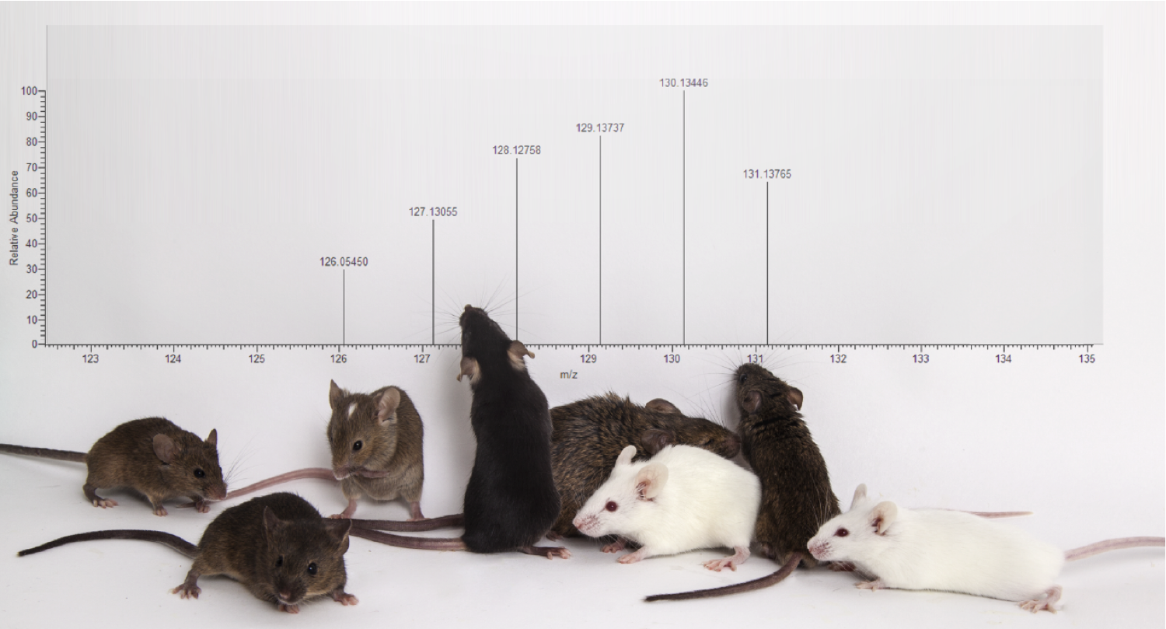
Questions?

Slide 21
Other results…

Slide 22
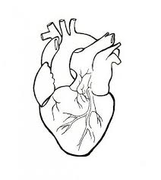

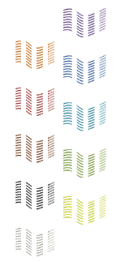
How does genetic variation influence protein abundance?
189 DO Hearts
RNA-Seq
Transcripts
Proteins
MS/MS
Short Reads
Peptides
eQTL
pQTL
eQTL Mapping
pQTL Mapping
Munger et al. 2014
Chick*, Munger* et al. Nature, 2016
Notes:
Impute individualized diploid genomes for each of the DO mice. Improves gene- and allele-level quantitation
Multiplexed quantitative proteomics performed by Joel Chick in Steve Gygi’s group at HMS.

Slide 23
Why use DO Mice?
Higher mapping resolution
More SNP locations that differ between mice
More genes and proteins will be differentially expressed
Con: Lower statistical power
More variants than across CC lines, less controlled genetics
Notes:
More SNP locations that differ between mice than locations that differ between strains of CCs (because of more observable recombination events)
“More genes and proteins will be differentially expressed.” That’s useful because
If two strains have a difference in a phenotype, say, cholesterol levels, and they are mostly genetically similar and only differ at a few SNPs, then
CCs are better for when replicate measurements are needed. So wet lab type stuff.
DOs are better for when you need to find which genes are associated with a phenotype. (There’s a better chance that with the DO, SNPs will differ between mice on the gene you are trying to look for, hence you will be able to find it)

Slide 24
Fluid shear stress and atherosclerosis
Glycolysis / Gluconeogenesis
Carbon metabolism
HIF-1 signaling pathway
Cellular hormone metabolic process
Regulation of peptidase activity
Dilated cardiomyopathy (DCM)
Hypertrophic cardiomyopathy (HCM)
Adrenergic signaling in cardiomyocytes
Sphingolipid signaling pathway

Slide 25
Transcript-Protein Correlations
Does the amount of correlation between mRNA and their respective proteins change with age or sex?
https://en.wikipedia.org/wiki/Central_dogma_of_molecular_biology
Notes:
Okay, so back to my project. In my case, my phenotypes are not observal phenotypes, like hair color or eye, nor are they even things like blood pressure which the doctor to measure. Instead, the phenotypes my data had were the levels of mrna and protein transcript in
Yes I took the image from Wikipedia. No shame.

Slide 26
Notes:
Overall correlations between mRNA and their respective proteins decreased with ag

Slide 28
Notes:
Why does mRNA-protein correlations decrease with age? Not sure, maybe the systems are just generally breaking down and aren’t work as tightly as they were simply due increasing entropy with age.

Slide 29
Additive vs Interactive QTLs
Additive covariates: Allows means between levels of the covariate to differ in the model.
Interactive covariate: Allows the genotype’s effect on the phenotype to vary with the levels of the interactive covariate.
Interaction Effect: Take the difference of the full model and the purely additive model
Notes:
WE use interactive covariates in our QTL model when we want to see if the effect of the QTL on the phenotype changes with the levels of the covariates.
So in the case of age, we would be able to see if our QTL effects our phenotype differently at different points in life.

Slide 30

Mediation Analysis for Interactive QTLs
pheno ~ QTL + addcovars
pheno ~ QTL + addcovars + QTL:intcovar
interaction effect
Effect of mediator on interaction
pheno ~ QTL + addcovars + mediator
pheno ~ QTL + addcovars + mediator + QTL:intcovar
interaction effect with mediator

Slide 31
Mediation Analysis Results – Chr3 Interactive pQTL trans-band
1110002E22Rik and Syde2 mediates genotype-age interaction effect of many proteins on chromosome 3 hotspot
Notes:
Mediators within 10 Mbp (Chick and Munger paper) of QTL pos for each gene in QTL hotspot

